Slide 1


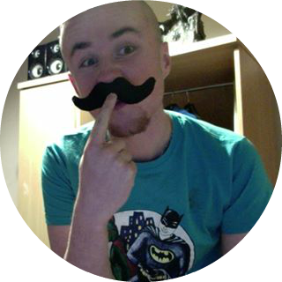

Note Tracking
Brie Lloyd-Evans
Robert Gabriel
Peter Bohane

Slide 3
Overview

Slide 4
Overview
Our idea is to create an app which
Record your class timetable
Alert you about upcoming classes
Take notes on the class within the same app.
Upload these notes to the cloud
Access all cloud based information on your smart phone, tablet, desktop device
There is no app like this on the market.
R

Slide 5

Aims
A Cross Platform app ( Android/iPhone and Web)
A Business model and plan for launch.
A Live website for Beta Signup.
R

Slide 6

Background
Constant timetable changes
Running late for class
Organisation of class notes
B

Slide 7
Research

Slide 8
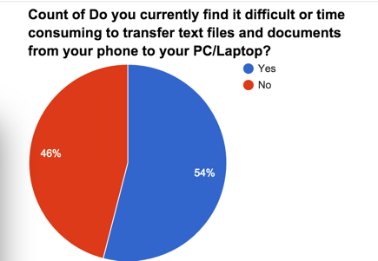
Research: Primary
Interviews
two key customer segments which include “College students” and “ Lecturers”.
learnt what they need and the struggles they have with current timetable and note taking app
Survey
B

Slide 9

Research : Secondary
Published texts: , Published statistics:
63% of people surveyed use apps for notes taking.
45% rise on tablets and phone use in college year on year
UK-At the end of 2013, 3.03 million people aged 16 to 24, or 42% of the total, were in full time education.
R
100,000,000
https://thejournal.com/articles/2013/05/08/report-students-use-smart-phones-and-tablets-for-school-want-more.aspx
http://www.pearsoned.com/wp-content/uploads/Pearson-HE-Student-Mobile-Device-Survey-PUBLIC-Report-051614.pdf

Slide 10






Technology
One Code base
Multiple Platforms
Android , Web, Ios
R

Slide 11
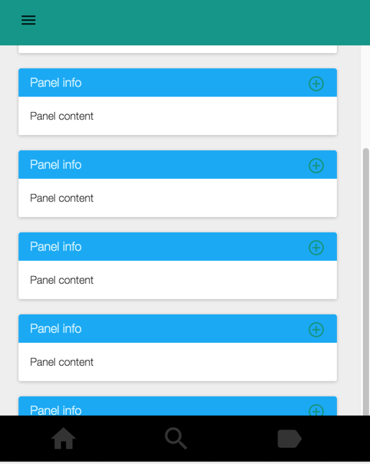
Robs Prototype
http://robertjgabriel.github.io/Note-Tracking-app-design-/
Will add more in the morning as it 4 am

Slide 12
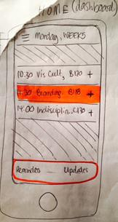
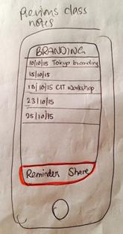
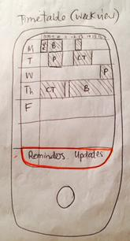
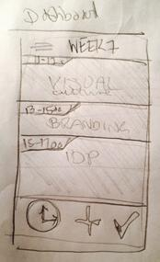
Bries Prototypes
Exploring the generic app layout; class notes, dashboard view, timetable. Started to meddle with different layouts. Too much information being given, could condense.

Slide 13
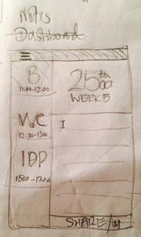
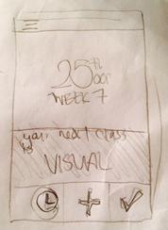
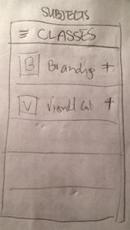
Bries Prototype
Researched different ways to show relevant and important information that would create an easy to use interface.
Introduced use of icons to simplify data.
Very geometric in appearance.

Slide 14
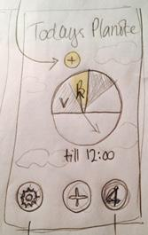
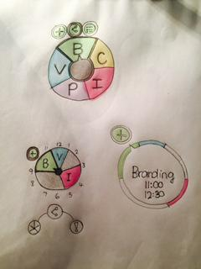
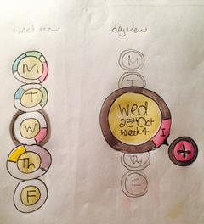
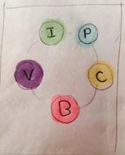
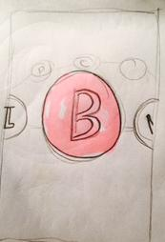
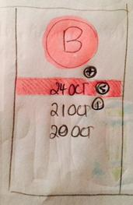
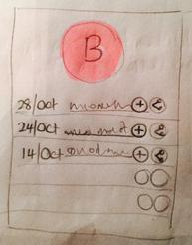
Bries Prototype
Continuing an exploration for a circular theme that relates back to the name ‘Planote’. Intuitive links that give you possible shortcuts to the screen you want to get to. Less is best for information.

Slide 15
Business Plan
Mission Statement
Born out of a passion for design, app development and problem solving, we are determined to build and deliver functional, beautifully crafted mobile and web applications to students, employees, schools, colleges and businesses.
Business Goals (Some of them )
Release a beta of the app to the Irish Google Play Store by 31/01/16.
Release the app on the Irish Apple App Store by 01/06/16 thus doubling our target market.
Advertise and approach schools and colleges about partnerships in preparation for the start of the 2016/2017 school year.
B

Slide 16
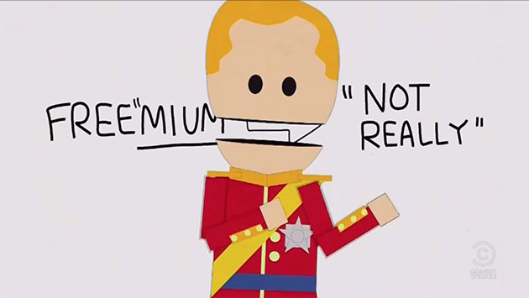
Pricing Models
Subscription ->
Continuous revenue, annual subscription 0.99c
Offering:
Increased online storage
Additional integrations
Customisation of layout through themes
Shareability
Widgets
B

Slide 17

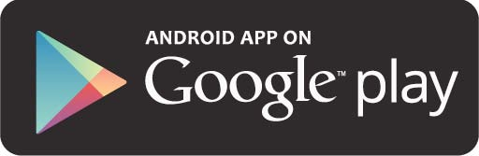
Business Plan
Place/channels of distribution ,

Slide 18
Business Plan : Revenue Projections
Month | 1 | 2 | 3 | 4 | 5 | 6
Sales € | 0 | 0 | 1400 | 1700 | 3000 | 4,000
Month | 7 | 8 | 9 | 10 | 11 | 12 | Total
Sales € | 6000 | 8000 | 10,000 | 12,942 | 15,000 | 15,000 | 63384

Slide 19
Conclusion

Slide 20
Conclusion
There is no other app like this one.
Our research reinforces that there is a gap in the market for this app and outlines our target group.
It can be profitable and expandable.
Design prototypes are being developed.
R

Slide 21

Thank you

